Slide 1
Instructions for the Research Question Demos
You have 3 minutes to present – be ready to share your screen, practice first. We can only offer you one opportunity to present so please make the most of it.
Research Questions are dependent on the variables and datatypes you have in your chosen dataset. Before going ahead with defining your Research Question, your dataset DSXXXX must be approved. I.e., did you get a confirmation email stating you have an assigned dataset (as per those listed in UH 365 Sharepoint LIST)? Your group number must be assigned to the dataset you are referencing here.
The next few slides give you three alternatives for how to define your research question and hypotheses. You will select only one type of research question. Before presenting DELETE all the texts that are either instructions or options you do not use (including this slide). You can then enlarge your selection.
We will send you instructions as to how to sign up. Sign up early. When the space runs out, we cannot issue any further. DO NOT SIGN UP unless you can attend. All the group members should attend but select one person to present.
We look forward to giving you feedback. You will not be graded on this presentation but if you do not attend and you booked a space you are preventing someone else presenting and are going against our module values. This will be reflected in your peer evaluation.

Slide 2

Research Question – Tutorial Presentation for Feedback Date: 1/11/24
Group Name: A129 Name of Student Presenting: X

Slide 3
This dataset is interesting to us because : In a time of emerging cryptocurrencies and extreme price fluctuations, it’s fascinating to explore historical data to identify potential seasonal trends in asset prices. From the column headings in your dataset choose ONE independent * and ONE dependent variable . Our Independent variable is: Season (created from Date) This Independent variable datatype is (select one): Nominal / categorial Our Dependent variable is: Daily Price Change (calculated as Close - Open) This Dependent variable datatype is (select one): Interval/measurement
Dataset ID: DS103 - Internet of Things Coins Historical Prices (IoTeX)
*For comparison of two nominal variables and for comparison of proportions you use two (or more) independent variables (see next slide)
Notes:
Before specifying your Research Question you must define the type of data you are analysing. Are the variables you select interval data (measurement data you can divide, multiple, etc), OR are they ordinal (there is a definite order but the intervals between each variable are not necessarily equal, or the terms might be subjective like in a likert scale); OR are they just categorical/nominal (Items such as film names, cities, etc., that you can count numbers of occurrences? You also need to understand whether the variable is either dependent or independent and this will vary according to the context. Independent variables may cause an effect, whereas the dependent variable might be effected by the independent variable. Check the lecture notes on the RQ for more information and examples.
You will get only one opportunity to present your Research Question ahead of the submission date. Have your questions ready, and be ready to take notes on feedback.

Slide 4
Template² :Interval/Ordinal vs Nominal. data “Is there a difference in the median daily price change of asset prices (dependent interval variable) between winter (independent nominal variable) and other seasons?”
Our Research Question is Choose ONE of the three templates below replacing the blue text with your variables – then add hypotheses as shown in next slide:
¹Correlation (Analysis of how ordinal/interval dependent var correlates to an ordinal/interval independent variable)
²Comparison of means (or medians): Analysis of the difference between the mean (or median) value of a characteristic shared by members of two different populations.
³Comparison of proportions: Analysis of the difference in proportions of a characteristic shared by members of two different populations.

Slide 5
Null hypothesis (H_{o}): There is no difference in the median daily price change between winter and other seasons. Alternative hypothesis (H₁); The median daily price change is higher in winter than in other seasons.
Add your hypotheses to the previous RQ Slide (both the Null and Alternative Hypotheses). Here are definitions and examples. Your wording will come directly from your RQ. This is the formal way of reporting the results of your inferential statistics, in which we report the effect the independent variable has on the dependent variable –
Leave the hypotheses as two statements for now – after your statistical analysis test, you will choose one or the other. (You will report: "We fail to reject the null hypothesis" with no significant result, or if you do have significance [p-value = < 0.05] you can state "We reject the null hypothesis". More guidance on hypothesis testing is given in the lectures.)

Slide 6
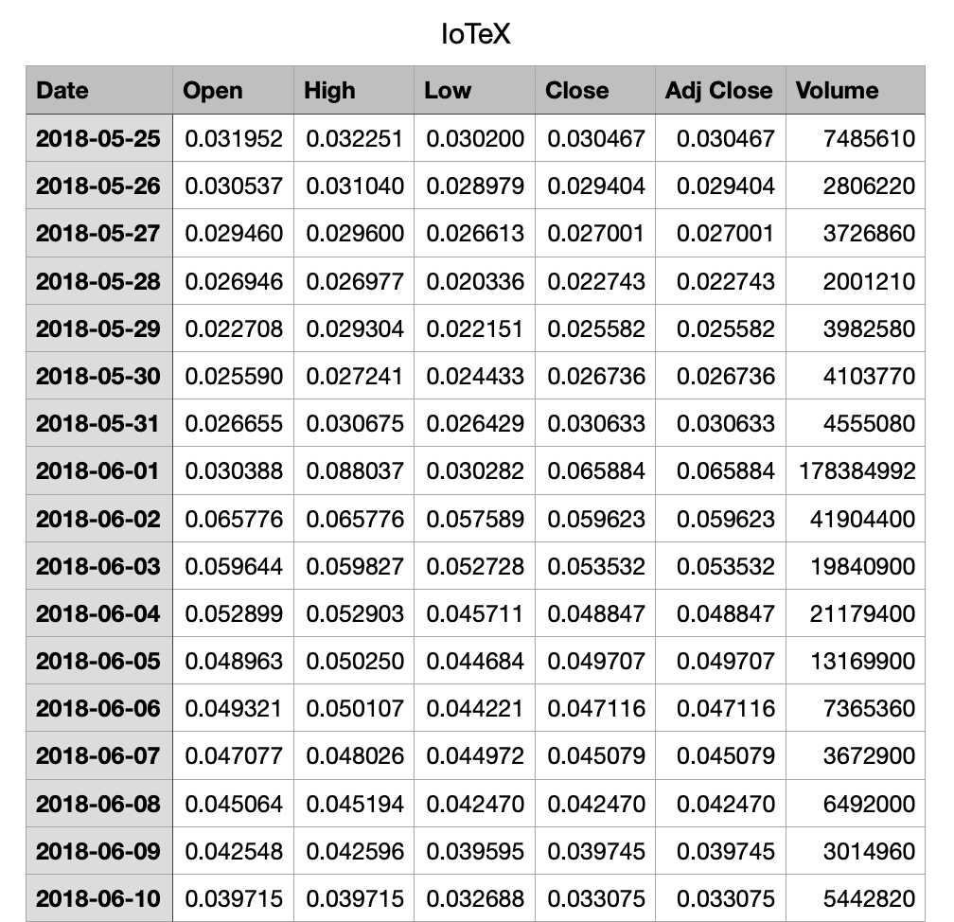
Dataset – Our data
A little snippet of our dataset

